Slide 1


Ethnobotanical Surveys about Wild Edible Plants
TANIA ISLAM
Assistant Professor
Computer Science & Engineering
University of Barishal
BARNA DAS
Dept. of Botany
Batch 49

Slide 2
Introduction:
Ethnobotany encompasses total, natural and traditional man-plant relationships, as well as for the practical applications of the biological knowledge of aboriginal people in medicine, health, agriculture and industry (Pawar, 2008). From ancient time plants have been used as a source of food, shelter, clothing, medicine, fibre, gum, resin, oil, etc. Several wild plants are used as food by tribals and other local people living in and around the forest areas (PY, 2010).Tribal and local people prefer wild vegetables over the cultivated as they grow naturally; provide better taste and good health. By selling these wild edibles to the nearby urban markets could earn them extra income (Setiya, 2016). Modern scientific researchers are trying to value these traditional food items to fill the gaps between growing population and food production (D. Sarker, 2013). The present studies were conducted to explore the knowledge of wild edible plants to meet the increasing demands of the growing population.

Slide 3
Ethnobotanical Survey
To perform the ethnobotanical survey questionnaires preparation is the important tool as it gives the relevant data for required study. The informant for collection of data is mainly the villagers, locals, traditional healers and priest resides in a particular community. The data collection through interview includes detail information of plants are being used from person to person. The herbarium preparation is also an important tool for the ethnobotanical survey. By the herbarium the identification and taxonomic classification of plants and documentation can be done. The survey includes common name, local name, scientific name of the plants, the plant parts that are used for different purposes.

Slide 4
Materials and Methods
Study Area
The whole area was surrounded by dense forest.
This information on wild edible plants is outcome of ethnobotanical field surveys and interviews among tribal people, ethnic men and women.
Data collection was made in different places i.e. forest and other woody areas, farm borders, grazing land etc.

Slide 5
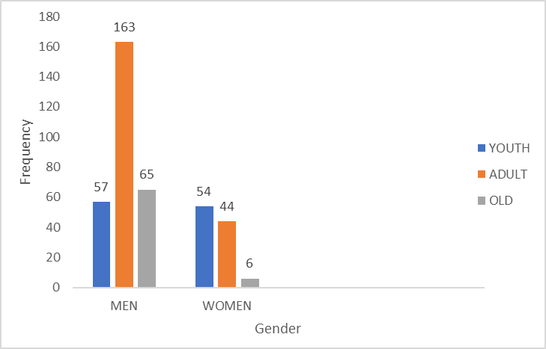
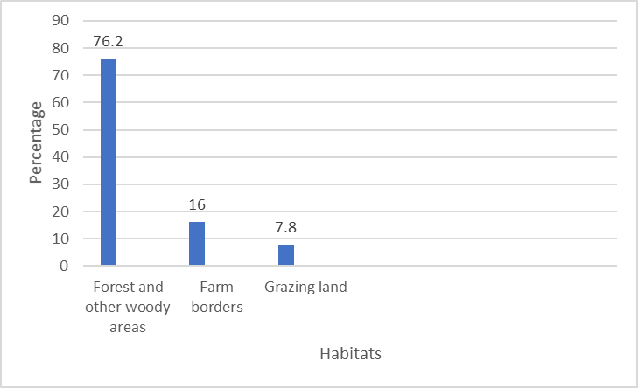
DATA COLLECTION
Fig.1 : Interviewing ethnic men & women
Fig.2 : Data collecting habitats

Slide 6
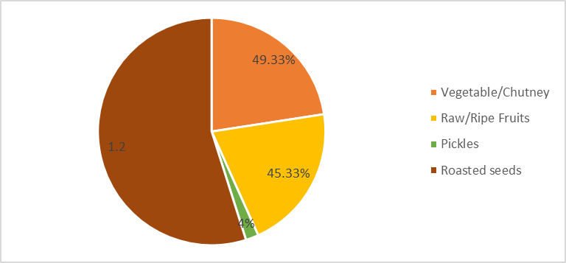
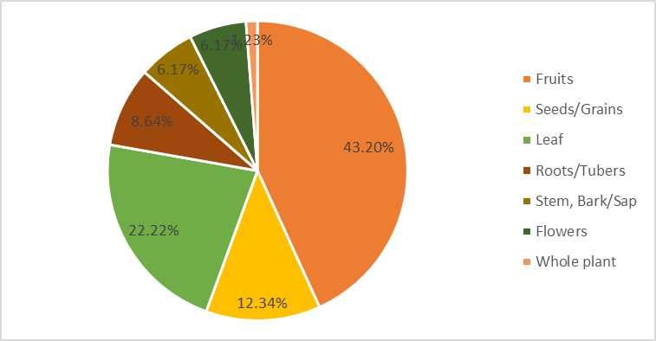
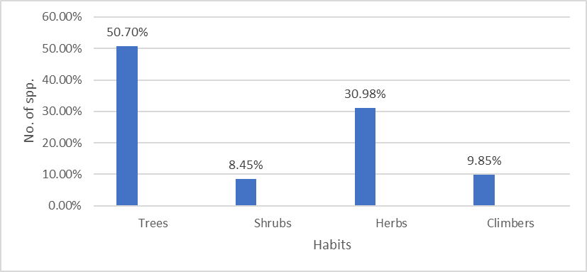
RESULTS
Fig.3 : Classification on the basis of usage
Fig.4 : Classification on the basis of parts used
Fig.5 : Wild edible plants growth habits

Slide 7
Conclusions:
Demand of food and vegetables of increasing population cannot be fulfilled unless we cannot find out the ways and means to increase the production of vegetables and other substitute like wild plants. So, it is of the immense need to document the indigenous knowledge of wild edibles for future generations and to encourage the peoples for cultivation of wild edible plants in their home gardens. Further research on cultivation and utilization of wild vegetables would help the tribal and rural people to have better nutrition.

Slide 8
References
D. Sarker, A. V. (2013). Ethnobotanical studies.
Ghosal, K. (2014). Ethnobotanical surveys.
Grivetti, L. (2000). Ethnobotanical surveys.
Kulkarni. (2006). Ethnobotanical surveys.
Pawar, S. A. (2008). Ethnobotanical studies.
Poudel, K. P. (2010). Ethnobotanical surveys.
PY, M. V. (2010). Ethnobotanical studies.
Quershi, P. (2014). Ethnobotanical surveys.
Rai, M. P. (2004). Ethnobotanical surveys.
Setiya, S. (2016). Ethnobotanical studies.
Sundriyal, M. S. (2003). Ethnobotanical surveys.

